Slide 1
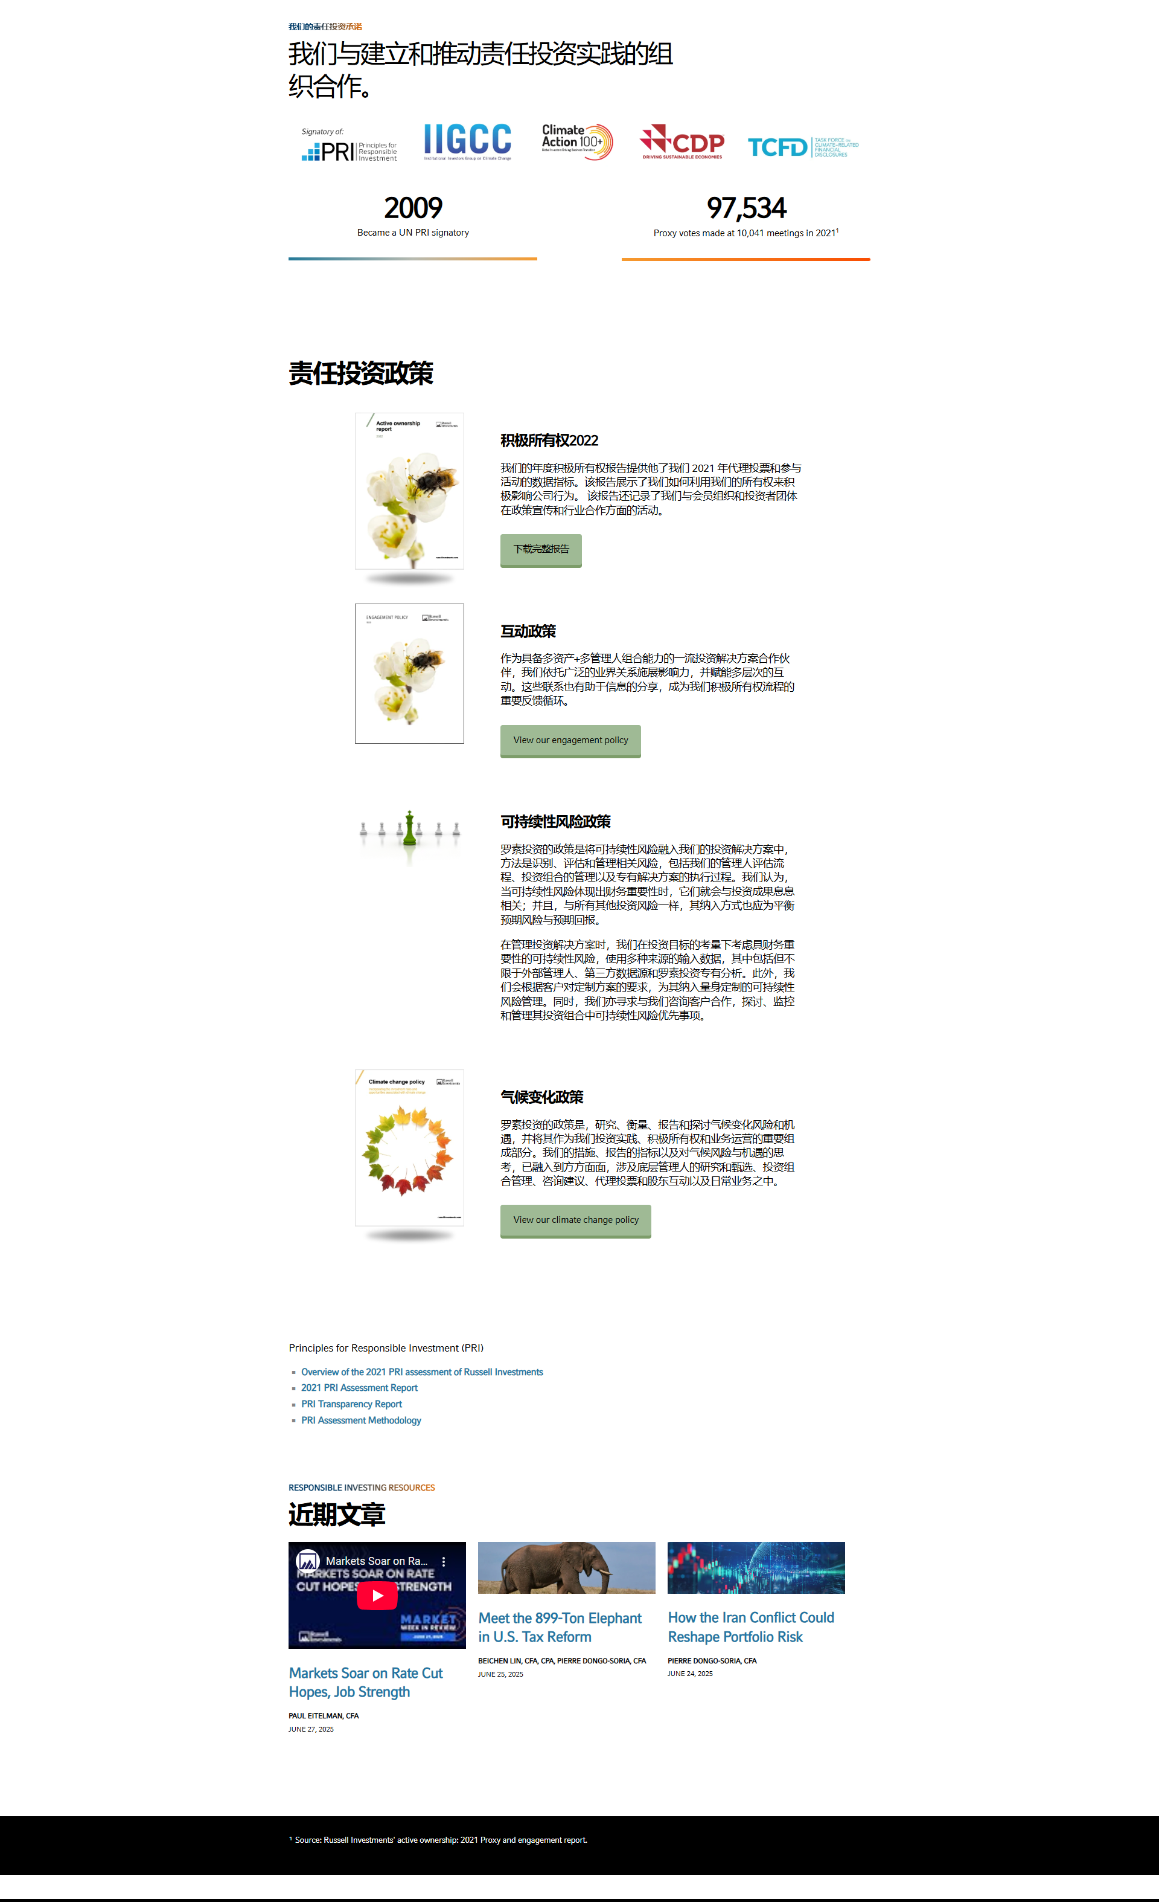
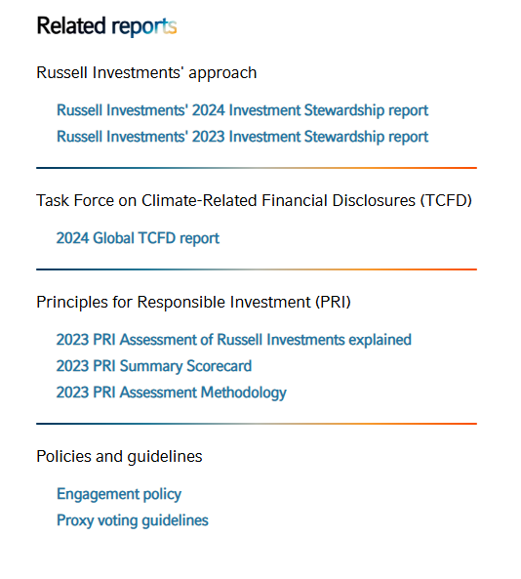
CHINA
https://russellinvestments.com/cn/solutions/sustainable-investing
92,350 proxy votes made at 9,265 meetings in 2024
Replace 2021 with 2024
投资管理报告 2024
Link to
https://russellinvestments.com/content/dam/ri/files/global/sustainable_investing/engagement-policyglobal.pdf
Edit title to read “2023 PRI Assessment Report”
https://russellinvestments.com/content/dam/ri/files/global/sustainable_investing/PRI-Summary-Scorecard.pdf
Remove overview document
https://russellinvestments.com/content/dam/ri/files/global/sustainable_investing/PRI-transparency-report.pdf
USE Links shown to left
https://russellinvestments.com/content/dam/ri/files/global/sustainable_investing/PRI-Assessment-Methodology.pdf
https://russellinvestments.com/content/dam/ri/files/global/sustainable_investing/engagement-policyglobal.pdf
https://russellinvestments.com/content/dam/ri/files/global/sustainable_investing/russell-investments-proxy-voting-guidelines.pdf

Slide 2
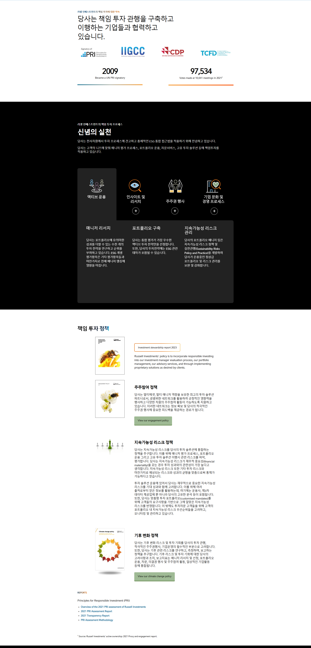
KOREA
https://russellinvestments.com/kr/about-us/sustainable-investing
92,350 proxy votes made at 9,265 meetings in 2024
Link to
https://russellinvestments.com/content/dam/ri/files/global/sustainable_investing/engagement-policyglobal.pdf
Edit title to read “2023 PRI Assessment Report”
https://russellinvestments.com/content/dam/ri/files/global/sustainable_investing/PRI-Summary-Scorecard.pdf
Edit title to read “Overview of the 2023 PRI Assessment” link to attached report.
https://russellinvestments.com/content/dam/ri/files/global/sustainable_investing/PRI-transparency-report.pdf
USE Links shown to left
https://russellinvestments.com/content/dam/ri/files/global/sustainable_investing/PRI-Assessment-Methodology.pdf
https://russellinvestments.com/content/dam/ri/files/global/sustainable_investing/engagement-policyglobal.pdf
https://russellinvestments.com/content/dam/ri/files/global/sustainable_investing/russell-investments-proxy-voting-guidelines.pdf

